Slide 1


INDIAN INSTITUTE OF SCIENCE EDUCATION AND RESEARCH, BHOPAL
Department Of Electrical Engineering and Computer Sciene
MODULE 2 - LINEAR TIME-INVARIANT SYSTEMS

Slide 2
MODULE 2 : LINEAR TIME-INVARIANT SYSTEMS
CONTENT
  INTRODUCTION
  LINEAR TIME-INVARIANT(LTI) SYSTEMS – DEFINITION
  DISCRETE-TIME LTI SYSTEMS : THE CONVOLUTION SUM
  CONTINUOUS-TIME LTI SYSTEMS : THE CONVOLUTION INTEGRAL
  PROPERTIES OF LINEAR TIME-INVARIANT SYSTEMS
  LTI SYSTEMS: DIFFERENTIAL & DIFFERENCE EQUATIONS
  DIFFERENTIAL & DIFFERENCE EQUATIONS : BLOCK DIAGRAM REPRESENTATION OF FIRST ORDER SYSTEMS
  SINGULARITY FUNCTIONS — IMPULSE, STEP & RAMP

Slide 3
INTRODUCTION
  Linearity and time invariance - two of the number of basis system properties.
  These properties play a fundamental role in signal and system analysis for two major reasons.
  First, many physical processes possess these properties and thus can be modeled as linear time-invariant (LTI) systems.
  LTI systems can be analyzed in considerable detail, providing both insight into their properties and a set of powerful tools that form the core of signal and system analysis.

Slide 4
Linear Time-Invariant (LTI) Systems — Definition
A Linear Time-Invariant (LTI) system is a system that satisfies both the linearity property and the time-invariance property.
Linearity:
A system is linear if it follows the superposition principle, which consists of:
(a) Additivity
If x1(t)→y1(t)
and x2(t)→y2(t)
then x1(t)+x2(t)→y1(t)+y2(t)
(b) Homogeneity (Scaling)
If x(t)→y(t)
then a x(t)→a y(t) a is any constant.
Combining both, a1x1(t)+a2x2(t)→a1y1(t)+a2y2(t)
Time Invariance :
A system is time-invariant if a shift in the input causes the same shift in the output.
If x(t)→y(t)
then for any delay t0 x(t−t0)→y(t−t0)
The system's characteristics do not change with time.

Slide 5
Discrete-Time LTI Systems : The Convolution Sum
  Representation of Input : Any DT signal can be expressed as a weighted sum of shifted unit impulses:
x[n] = Σ x[k] δ[n−k].
  Impulse Response : with the input x[n] to a linear system expressed in the above expression, the output y[n] can be expressed as
y[n] = Σ x[k] hk[n].
  Convolution Sum : The convolution or superposition sum will represent symbolically as
y[n] = x[n] * h[n] =Σ x[k] · h[n−k] k = - ∞ to + ∞

Slide 6
Continuous-Time LTI Systems : The Convolution Integral
  Representation of Input : Any CT signal can be expressed as a weighted sum of shifted unit impulses:
x(t) = ∫ x(τ) δ(τ).
  Impulse Response : with the input x(t) to a linear system expressed in the above expression, the output y(t) can be expressed as
y(t) = ∫ x (τ) h τ(t) dτ.
  Convolution Integral : The convolution or superposition integral will represent symbolically as
y(t) = x(t) * h(t) =∫ x(τ) · h(t−τ) dτ [−∞ to +∞]

Slide 7
Properties of Linear Time-Invariant Systems
  The Commutative Property :
In discrete time , x[n] * h[n] = h[n] * x[n] = Σ h[k] · x[n−k] k = -∞ to + ∞
In continuous time , x(t) * h(t) = h(t) * x(t) = ∫ h(τ) · x(t−τ) dτ [−∞ to +∞]
  The Distributive Property :
In discrete time , x[n] * (h1 [n] + h2[n]) = x[n] * h1 [n] + x[n] * h2[n]
In continuous time , x(t) * [h1 (t) + h2 (t)] = x(t) * h1 (t) + x(t) * h2 (t)
  The Associative Property :
In discrete time , x[n] * (h1 [n] * h2[n]) = (x[n] * h1 [n]) * h2[n]
In continuous time , x(t) * [h1 (t) * h2 (t)] = [x(t) * h1 (t)] * h2 (t)
  Invertibility of LTI Systems :
In discrete time, h[n] *h1 [n] = δ[n].
In continuous time, h(t) *h1 (t) = δ(t).

Slide 8
Properties of Linear Time-Invariant Systems
  LTI Systems with and without Memory :
A discrete time LTI system is memoryless if h[n] = 0 for n ≠ 0. In this case the impulse response has the form h[n] = K δ[n], where K = h[0] is a constant, and the convolution sum reduces to the relation y[n] = Kx[n].
A continuous time LTI system is memoryless if h(t) = 0 for t ≠ 0, and such a memoryless LTI system has the form y(t) = Kx(t) for some constant K and has the impulse response h(t) = K δ(n)
  Causality for LTI Systems :
A discrete time LTI system is casual if h[n] = 0 for n < 0.
A continuous time LTI system is casual if h(t) = 0 for t < 0.
  Stability for LTI Systems :
In discrete time , the system is stable if Σ |h[k]|< ∞
In continuous time , the system is stable if ∫ |h(τ) |dτ < ∞
  The Unit Step Response of an LTI Systems :
In discrete time, s[n] = Σ h[k] (from k = - ∞ to n)
In continuous time, s(t) = ∫ h(τ) dτ (from τ = - ∞ to t)

Slide 9
LTI Systems: Differential & Difference Equations
CT — Linear Constant-Coeff. Differential Eq.
General Form:
Σ aₖ (dᵏy/dtᵏ) = Σ bₖ (dᵏx/dtᵏ)
First-order example:
dy(t)/dt + ay(t) = bx(t)
DT — Linear Constant-Coeff. Difference Eq.
General Form:
Σ aₖ y[n−k] = Σ bₖ x[n−k]
First-order example:
y[n] − ay[n−1] = bx[n]
Solution Approach for Causal LTI Systems:
1. Homogeneous (Natural) Response: Set input x = 0, solve for yₕ (characterizes system's natural behavior).
2. Particular (Forced) Response: Find yₚ due to input x(t) or x[n].
3. Complete Solution: y = yₕ + yₚ, apply initial conditions to find constants.

Slide 10
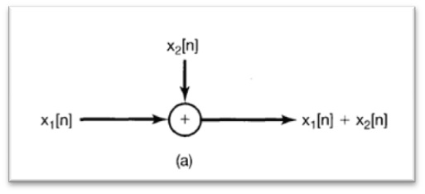
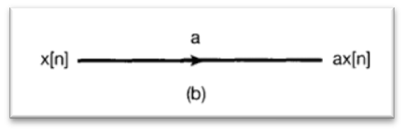
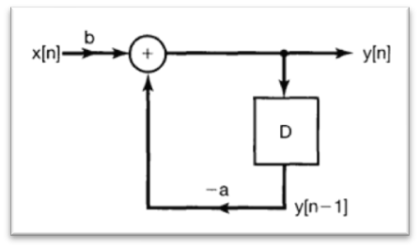
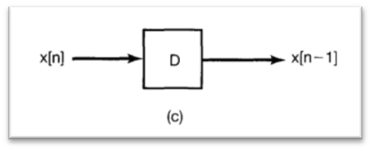
Differential & Difference Equations :
Block Diagram Representation of First Order Systems
DT — Linear Constant-Coeff. Difference Eq.
Basic elements for the block diagram representation of the causal system:
(a) an adder; (b) multi plication by a coefficient; (c) a unit delay.
Block diagram representation for the causal discrete-time system

Slide 11
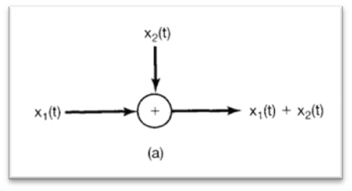
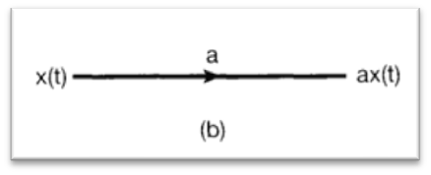
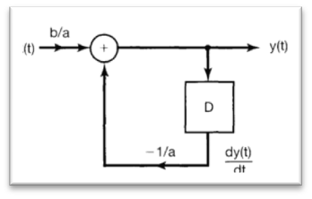
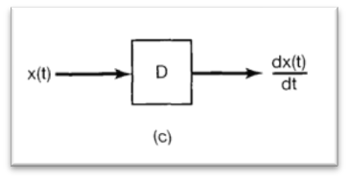
CT — Linear Constant-Coeff. Differential Eq.
Basic elements for the block diagram representation of the continuous-time system:
(a) an adder; (b) multiplication by a coefficient; (c) a differentiator.(d)
Block diagram representation for the system, using adders, multiplications by coefficients, and differentiators.

Slide 12
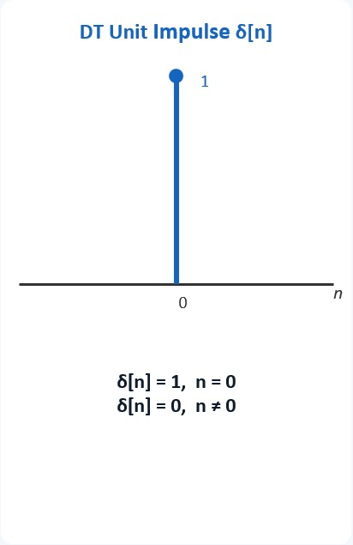
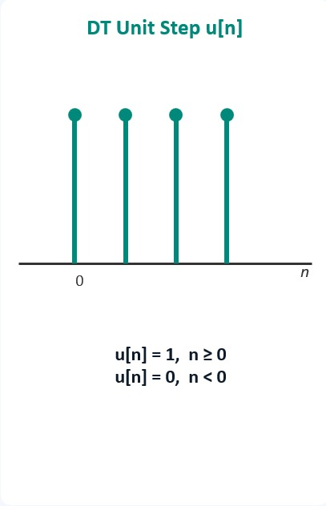
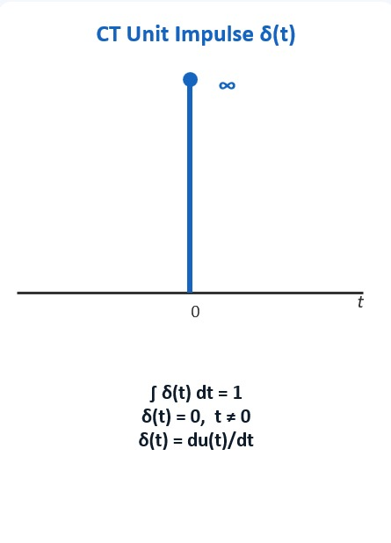
Singularity Functions — Impulse, Step & Ramp

Slide 13
Module - 2
Completed

